Slide 1

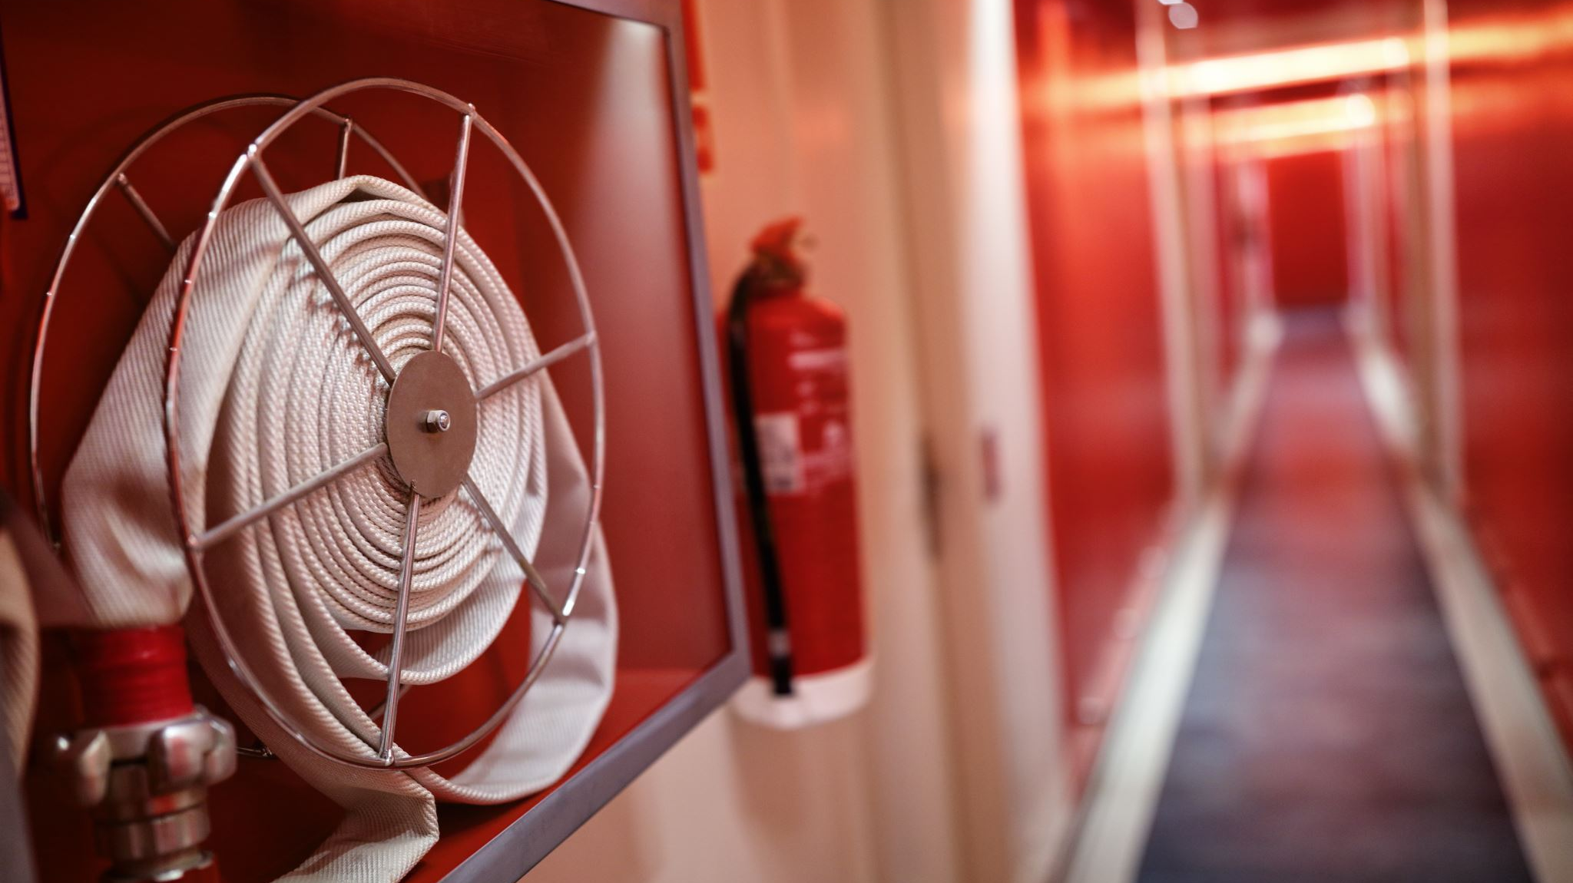


Safety Equipment
By.kerllie Georges

Slide 2

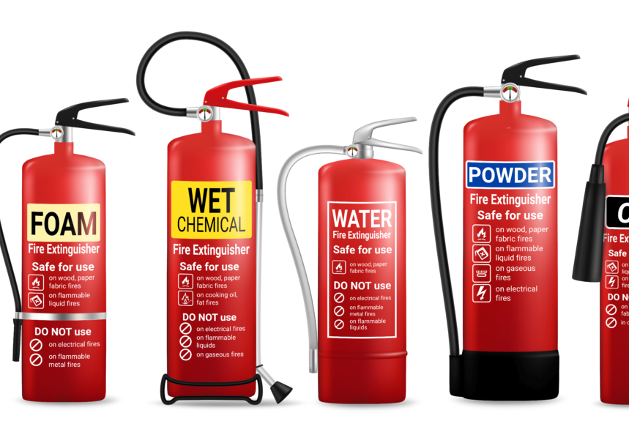
Fire Extinguishers
something used to put out a fire. especially : a portable or wheeled device for putting out small fires by spraying fire-extinguishing chemicals.

Slide 3
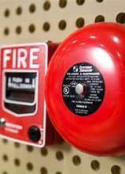
Fire Alarms
A fire alarm is a unit made of several devices, which uses visual and audio signaling to warn people about a possible fire, smoke, or carbon monoxide occurrence in the area of coverage.

Slide 4
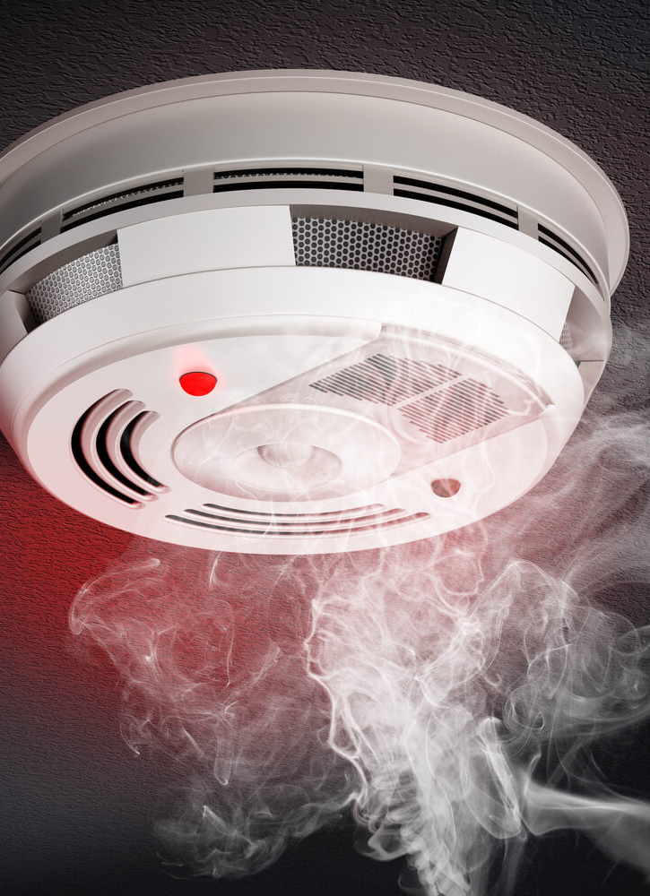
smoke detector
A smoke detector is an electronic fire-protection device that automatically senses the presence of smoke, as a key indication of fire, and sounds a warning to building occupants.

Slide 5
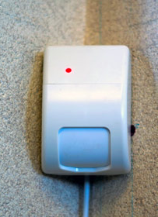
Burglar Alarms
An alarm system can be installed at residential as well as commercial places and depending upon the location some devices are installed inside and some outside of the premises.

Slide 6

Non-Skid Mats
Anti-skid mats are layers of patterned rubber or plastic that are placed on the ground or on treacherous areas, such as stairs or ladders.

Slide 7
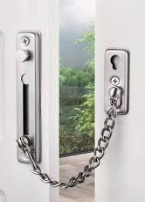
Door Chains
A door chain, security chain, or security door chain or chain door interviewer consists of a small chain attached to the door frame, which attaches to a track on the door for security purposes. It is a type of lock that is often used along with other types of locks to secure a door.

Slide 8
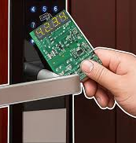
lectronic Locks
An electronic lock (or electric lock) is a locking device which operates by means of electric current. Electric locks are sometimes stand-alone with an electronic control assembly mounted directly to the lock.

Slide 9
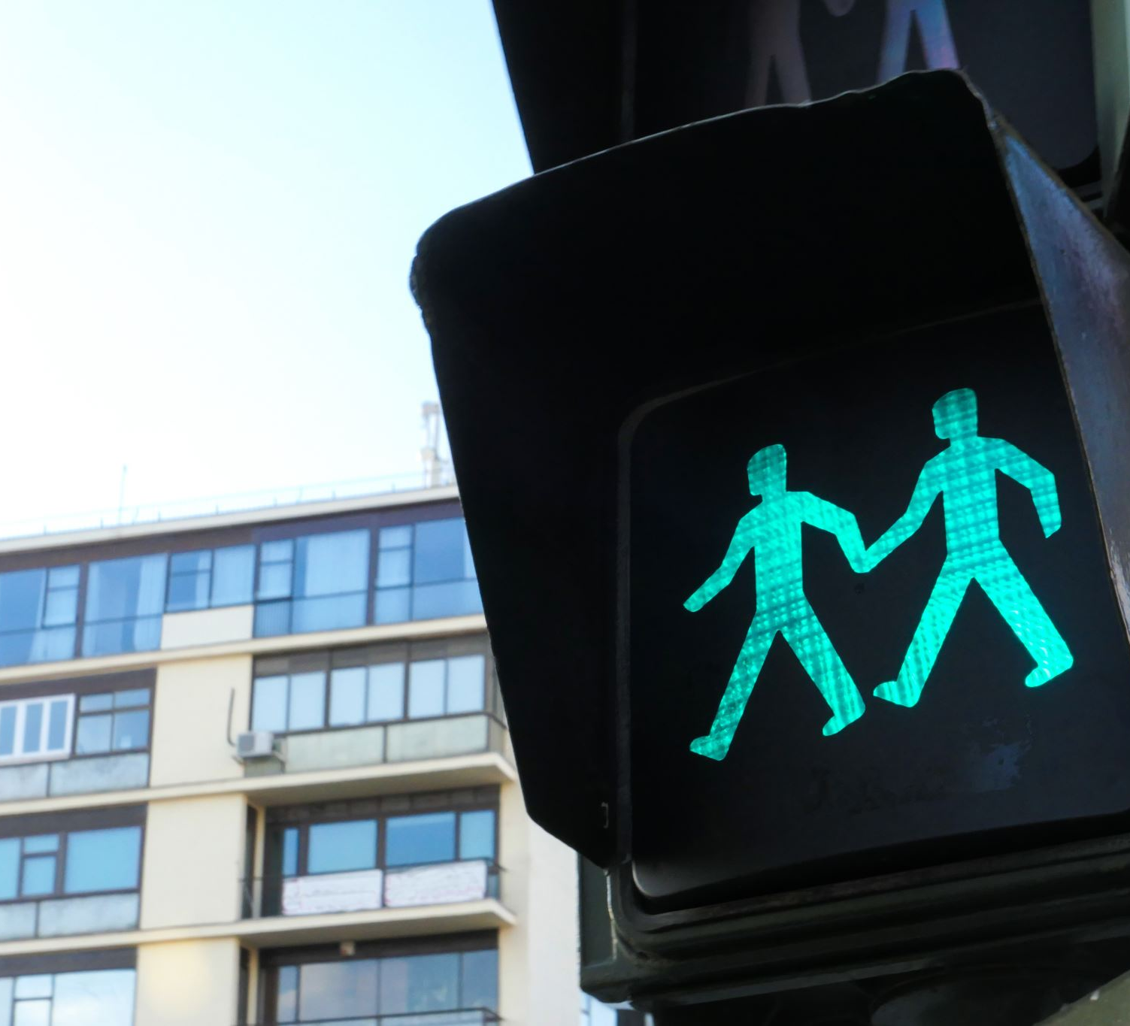
Safety Signs
By kerllie Georges

Slide 10

Sign: No food or Drink
A "No Food or Drink" sign is used to communicate a policy prohibiting the consumption or presence of food and beverages in a specified area. This restriction is usually put in place to maintain cleanliness, protect equipment, preserve a controlled environment, or uphold a certain standard of decorum.

Slide 11

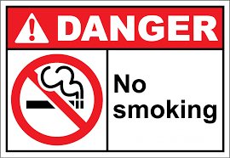

No smoking
Role of no smoking safety signage:"No Smoking" signs help businesses to comply with smoke-free regulations. Businesses must display at least one legible no smoking sign at each entrance to a smoke-free premise, stating that it is illegal to smoke on the premises. The sign must: Be clear and easy to read.

Slide 12
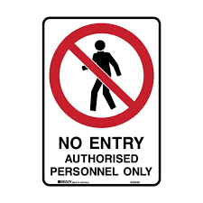
No entry authorized personnel only
The primary benefit of "No Admittance - Authorised Personnel Only" signs is their ability to deter unauthorised access. The bold and eye-catching design, combined with the clear message, sends a strong signal that certain areas are off-limits to unauthorised individuals.

Slide 13
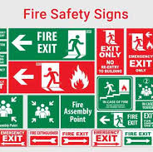
Exit
Fire escape signs are provided to guide people from wherever they are in a building, via a place of relative safety. (the escape route)...

Slide 14

NO Running
A No Running Sign is a prohibition message type of safety sign which is often seen displayed around areas where it is necessary to stop and prevent people from running and No Running Signage conveys the message "No running" which means it is prohibited for anyone to be running in this location.

Slide 15

Keep work area tidy
Clearly inform staff that certain areas must be kept clean and tidy. Ideal for use in food preparation rooms as well as packing areas in warehouses. Use to reinforce good hygiene practices and to retain excellent health and safety records.

Slide 16
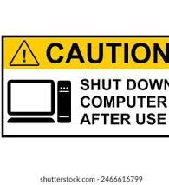
Shut down computer after use
Two words as a verb, one word as a noun. Use shut down to describe exiting the operating system and turning off the device in a single action. Don't use shut down to describe turning off a device or as a synonym for close. Examples. To turn off your computer, select Settings, and then select Shut down.

Slide 17
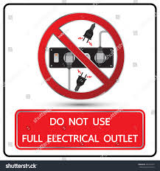
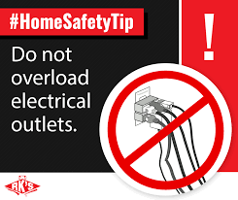
Do not overload electrical sockets
Never overload an extension lead by plugging in appliances that together will exceed the maximum current rating stated for the extension lead. This could cause the plug in the wall socket to overheat and possibly cause a fire.

Slide 18
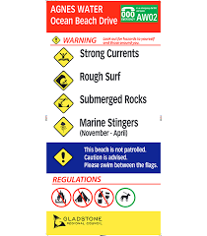
Surf safely
the practice of using security measures to protect one's computer while surfing the internet.
The phrase "Surf safely" typically refers to practicing safe behaviors while surfing, whether it's on the internet or in the ocean. In the context of internet safety, it encourages users to be cautious about online activities, protect personal information, and avoid risky behavior. When related to actual surfing, it emphasizes awareness of water conditions, understanding one's skill level, and using appropriate safety gear. Overall, it promotes a mindful and responsible approach to enjoying surfing in any form.

Slide 19
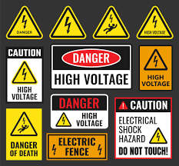
Electrical Hazard
What are electrical hazard signs? Electrical hazard signs are a danger sign, meaning they are used to highlight risks that are likely to result in death - in this case, electrical shock. Electrical signs use a yellow triangle with black borders, text and pictograms.

Slide 20

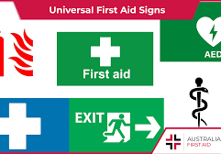
First Aid
The first aid kit sign is a universal sign that signals the direction or location of first aid or safety equipment and other emergency related facilities.

Slide 21
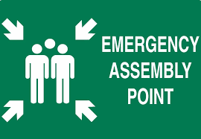
Emergency Assembly Point
These are also referred to as fire assembly signs or even muster point signs, but they all mean the same thing – they show the designated area where you need to gather during an emergency.

Slide 22
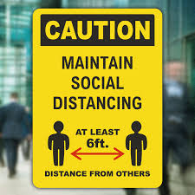
Social Distancing
Practice Social Distancing While Waiting Signs has the meaning of we must maintain our social distancing and can keep practising our social distancing measures of 2 metres apart whilst and Practice Social Distancing While Waiting Signage conveys the message "Practice Social Distancing While Waiting" which means to keep ...

Slide 23

Sanitize Hands
These hygiene reminder signs help reduce risk of spreading the virus and other contaminations associated with Hand Hygiene. We have a large range of Wash Your Hands signs and Use Hand Sanitiser Signs available to help keep reminding people of the importance of good hygiene.

Slide 24
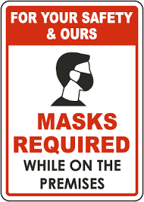
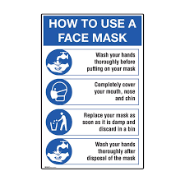
Wear Face Mask
A Wear mask sign is a mandatory message type of personal protective equipment sign which is used for being displayed around areas to instruct and ensure people wear a face mask for their own protection and Wear Face Mask Signs conveys the message "Wear mask" which means it is a mandatory requirement that masks must be ...

